Slide 1
CS246: Leveraging User Feedback
Junghoo “John” Cho
UCLA

Slide 2
Improving Search Engine Via User Feedback
Q: Once we deploy a search engine, can we improve it through user interaction?
Q: How can users’ “feedback” be used?
A: Possibilities
Rerank documents
Evaluate ranking function
Expand benchmark query set

Slide 3
2. Evaluating Ranking
Q: How can we use user’s interaction to evaluate whether our new ranking is better than the old one?
A/B testing: common technique to compare the performance difference of two versions
Serve two different versions, A and B, to users (without telling them)
Measure the performance difference between the two

Slide 4
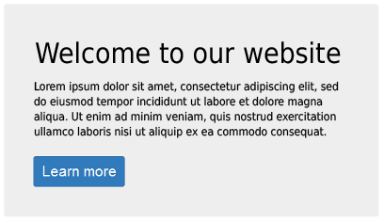
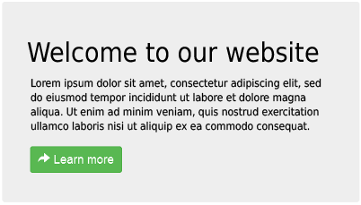
A/B Testing Example
Q: Which colored button do users notice and click more?
Click rate: 35%
Click rate: 17%

Slide 5
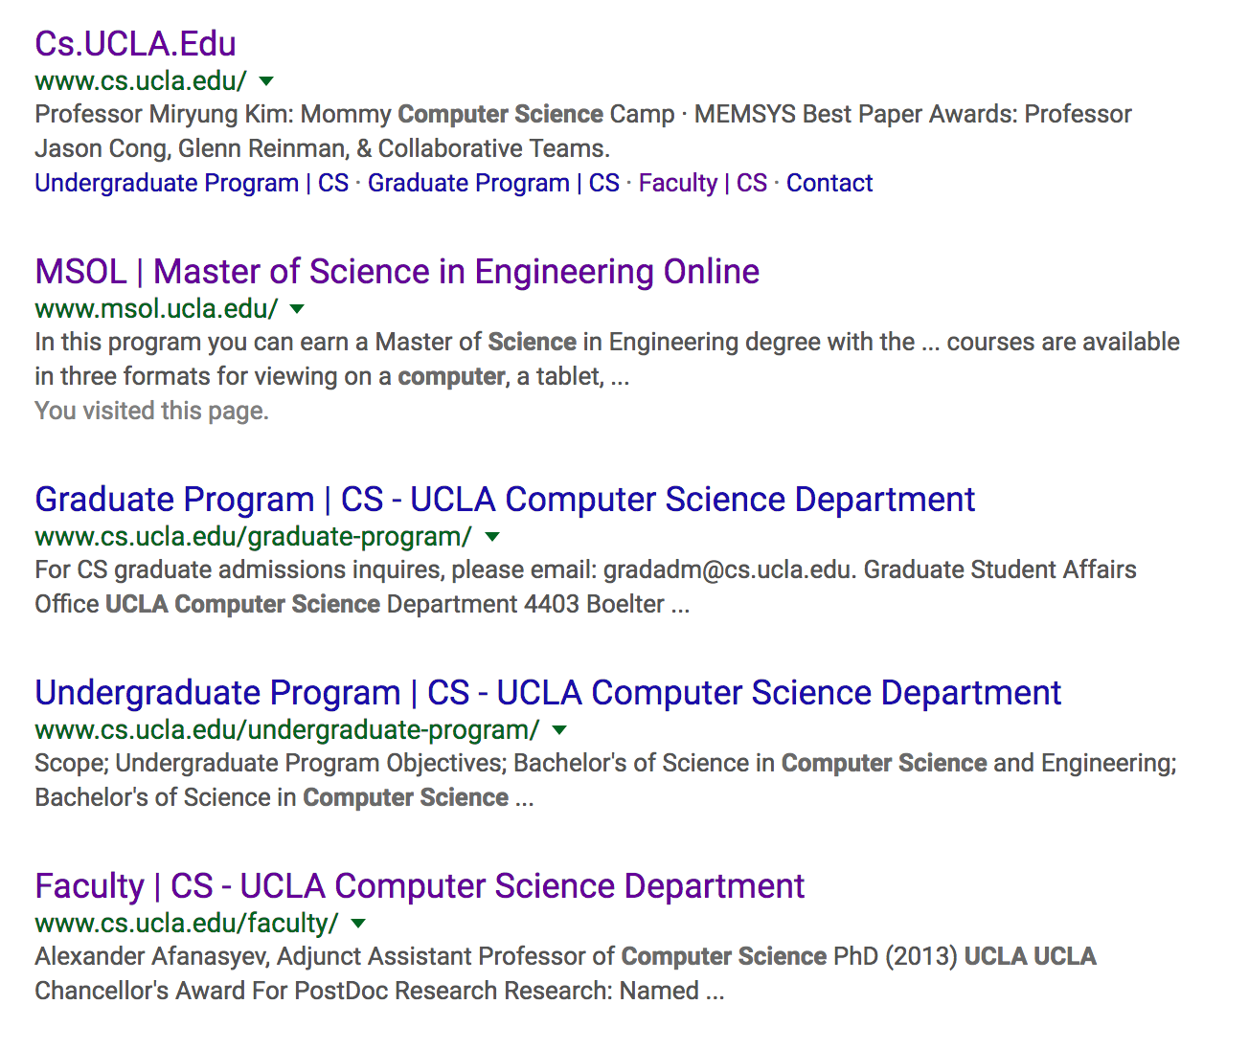
A/B Testing for Ranking Evaluation
UCLA CS
Q: What should we measure to compare?

Slide 6
Difficulty of Ranking Evaluation
Using users’ click behavior is a very noisy signal
Ambiguity in interpreting users’ behavior
Does more clicks mean more relevant results?
Do users’ clicks influenced by ranking in the result?
Did users stop clicking because they found what they looked for or because they gave up?

Slide 7
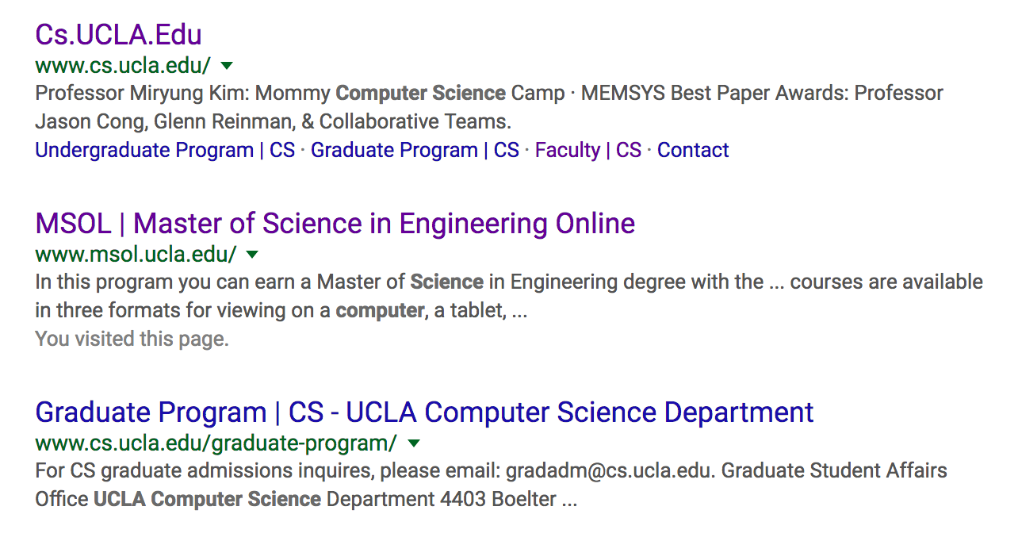
A/B Testing via Merged Ranking [Joachims 03]
Instead of showing two separate ranked results, show one merged result
The ranking that gets more clicks in the merged result is better
Removes many ambiguities arising from two separate lists
Q: Is it true?
A
B
A
B
A
B
A

Slide 8
Expanding Benchmark Query Set
Expand benchmark query set through users’ click data
Q: How can we identify “relevant” pages?
Again, very tricky due to the ambiguity of users’ behavior, but
Are users clicks heavily focused on a particular page even after changes in their position?

Slide 9
Summary
Improve search engine through user feedback
Implicit vs explicit vs “peudo”
Users are reluctant to provide any explicit feedback
User behavior is ambiguous and difficult to interpret
Three possible ways to use users’ feedback
Rerank documents
Evaluate ranking
Expand benchmark query set

Slide 10
References
[Joachims 03] Thorsten Joachims: Evaluating Retrieval Performance using Clickthrough Data in Text Mining, 2003

